Slide 1
Predicting liver disease by using machine learning models
TRGN515 Cheng-Hsiang (Sam) Lu
Instructor: Dr. Baloglu
Notes:
Hi Everyone, My name is Sam. I’m a first-year Bioinformatics master student in USC. My major is Translational Biomedical Informatics.
Today, the topic I’m going to talk about is:
“Predicting liver disease by using machine learning models”

Slide 2
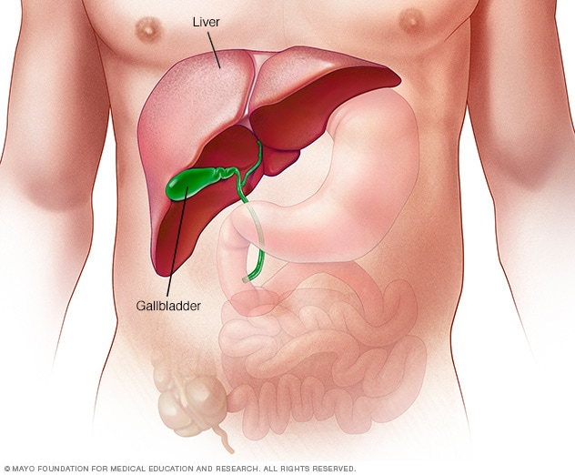
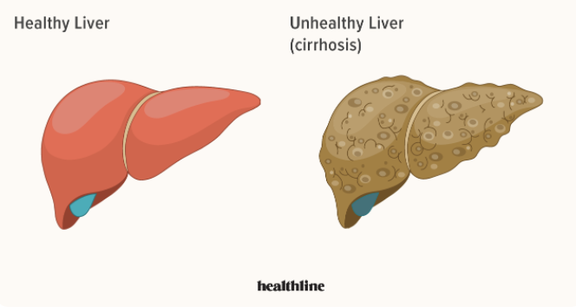
Introduction
Liver
The largest solid organ
Major functions
Metabolizing bilirubin, fat, and proteins
Supporting blood clots
Immunological function
Producing albumin
Liver disease
Cirrhosis
Liver failure
Liver cancer
https://www.medicalnewstoday.com/articles/305075#regeneration
https://my.clevelandclinic.org/health/diseases/17179-liver-diseas
https://www.mayoclinic.org/diseases-conditions/liver-problems/symptoms-causes/syc-20374502e
https://www.healthline.com/health/liver-diseases
Notes:
First, I would like to talk about liver.
The liver is the largest solid organ in the human body.
About the size of a football
It's located mainly in the upper right portion of your abdomen, beneath the diaphragm and above your stomach.
It carries out over 500 essential tasks.
The major functions of liver include:
metabolizing bilirubin, Fat, and proteins,
Supporting blood clots, Immunological function,
Producing albumin, etc.
The term “liver disease” refers to any of several conditions that can damage your liver.
Over time, liver disease can cause cirrhosis.
As more scar tissue replaces healthy liver tissue, the liver can no longer function properly.
If left untreated, liver disease can lead to liver failure and liver cancer.

Slide 3
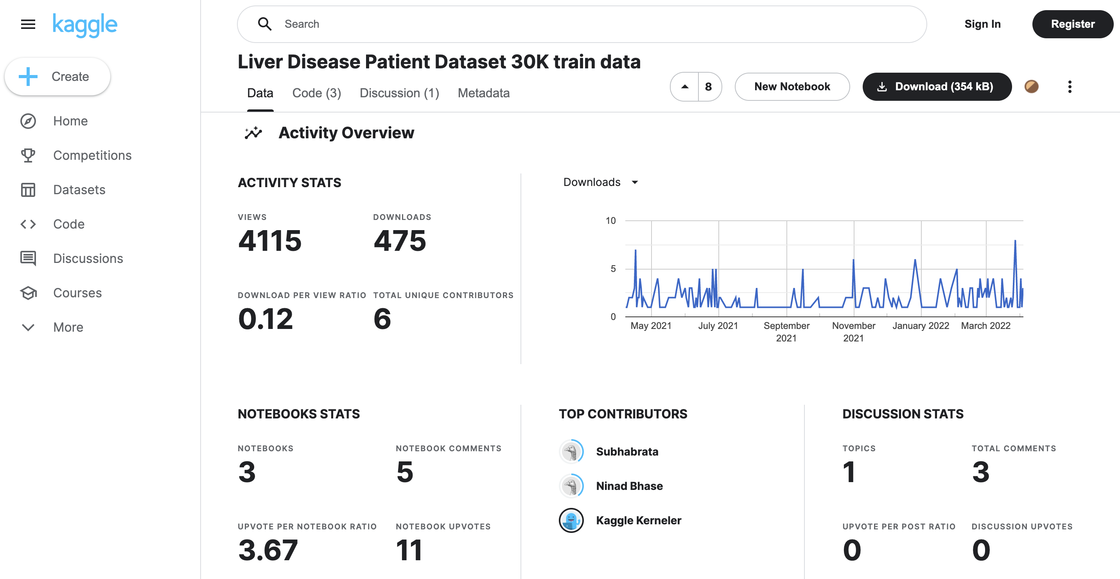
Dataset
Liver Disease Patient Dataset
Kaggle
Contains 30,691 data points and 11 features
https://www.kaggle.com/datasets/abhi8923shriv/liver-disease-patient-dataset
Notes:
Now, let take a look at my dataset. This dataset was found on Kaggle.
And it has been viewed 4 thousand times and been downloaded almost 500 times.
It contains more than 30 thousand data points and 11 features.

Slide 4
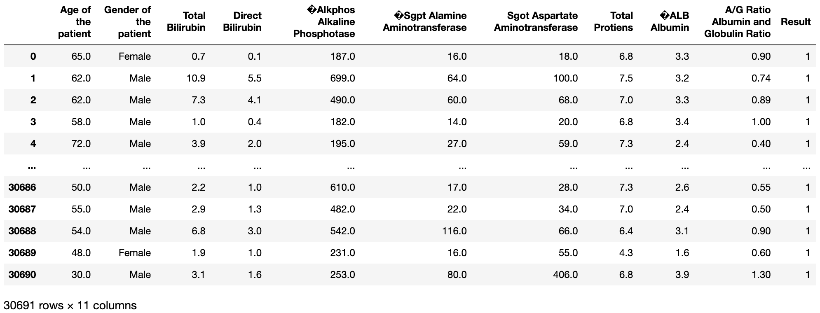
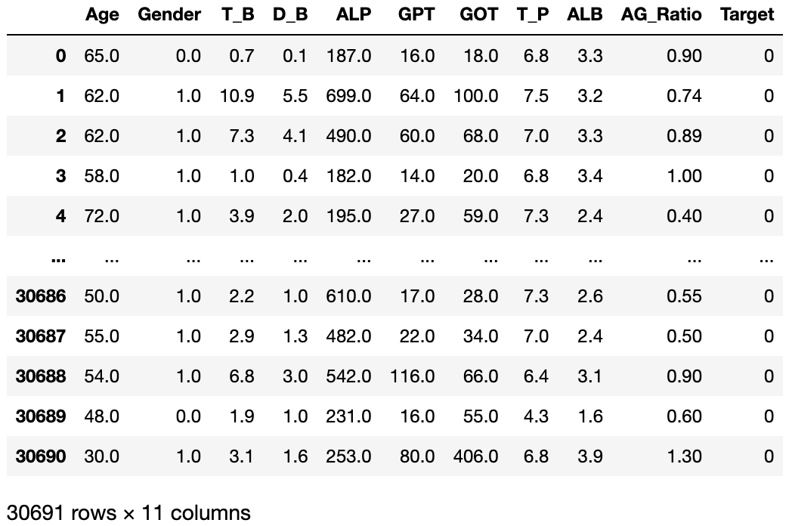
Dataset
Features:
Age
Gender
0 - Female
1 - Male
Total Bilirubin (T_B)
Direct Bilirubin (D_B)
Alkphos Alkaline Phosphotase (ALP)
Sgpt Alamine Aminotransferase (GPT)
Sgot Aspartate Aminotransferase (GOT)
Total Proteins (T_P)
Albumin (ALB)
Albumin and Globulin Ratio (AG_Ratio)
Target
0 - without liver disease
1 – liver disease
https://www.hopkinsmedicine.org/health/treatment-tests-and-therapies/common-liver-tests#:~:text=Serum%20bilirubin%20test.,of%20bile%20by%20the%20liver.
https://www.kaggle.com/datasets/abhi8923shriv/liver-disease-patient-dataset
Notes:
After converting It’s headers into acronyms
and changing categorical data like “gender” into numbers (0 and 1),
There are10 features which are Age, Gender, total Bilirubin, direct Bilirubin,
ALP, GPT, GOT,
Total Proteins, Albumin, and AG_Ratio
When it comes to liver, expect for Age and Gender, these are the most commonly performed blood tests
There is one target that has two classes:
0 correspond to sample without liver disease
And 1 correspond to sample with liver disease
The goal for my presentation today is to predict liver disease by using these data points and features
Next thing I would do is to explore the data and see which features are more important
and then use them to build my model

Slide 5
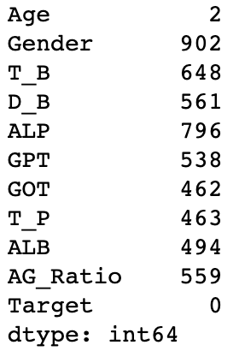
Missing values
Checking my dataset for missing values
Remove all missing values (drop 12% of all data)
Replace all missing values with mean or median
Missing_values_count
Notes:
First, I checked my dataset to see if there are missing values
Unfortunately, All features contain missing values
You can see them from the figure on the right side.
Then, I decided whether I should remove them or not
I tried to remove all of them, but 12% of my dataset would disappear
Therefore, I change to replace all missing values with means or median.
#(30,691 to 27,158 data points)

Slide 6
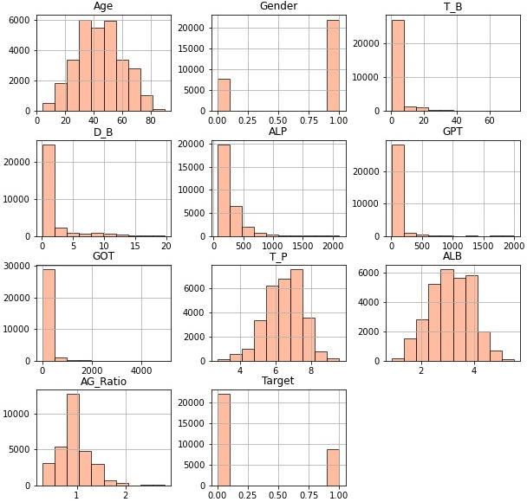
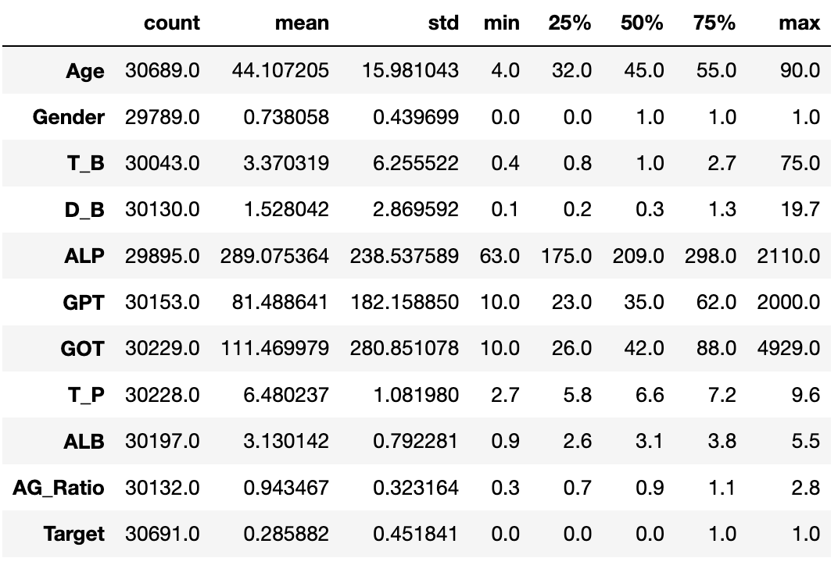
Mean or median
From histograms and the description table,
For Age, T_P, ALB, and AG_Ratio, we can replace their missing values with means.
For T_B, D_B, ALP, GPT, and GOT, we can replace their missing values with medians.
Notes:
From histograms and my description table,
I can see that histograms of Age, T_P, ALB, and AG_Ratio look like a normal distribution.
So, we can replace their missing values with means.
On the other hand, histograms of T_B, D_B, ALP, GPT, GOT look like a skewed distribution.
Thus, we can replace their missing value with medians.

Slide 7
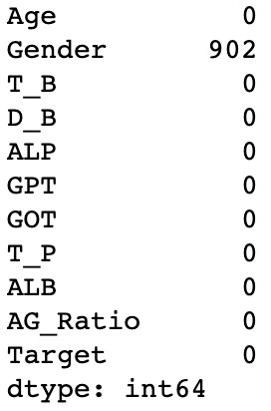
Missing values
I remove gender missing values because they are less than 3% (902 points) of all data points(30,691 to 30,059 data points).
Missing_values_count
Notes:
After that, only the gender feature contain missing values.
However, I cannot replace them with mean or median because gender is a categorical data.
But, based on these missing values of Gender are less than 3% of all data points, I just remove them.

Slide 8
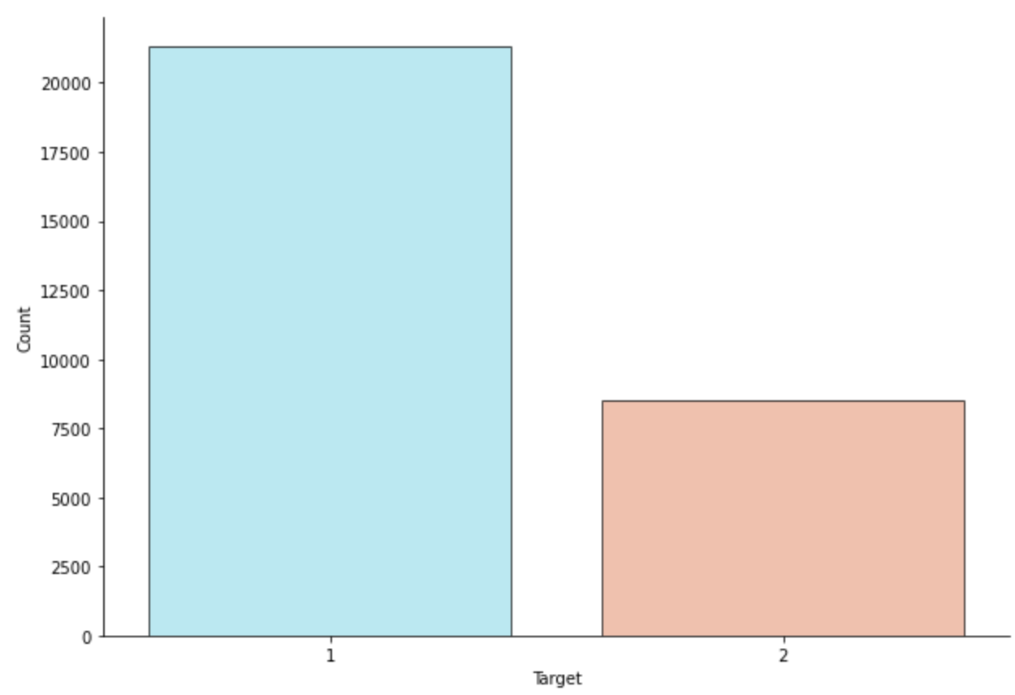
Imbalanced dataset
Based on value counts from Target:
21,295 data points with liver disease
8,494 data points without liver disease
LD
No_LD
Reduce the data points in liver disease group
Notes:
Then, I take a closer look at my dataset’s target distribution and find out that my dataset is imbalanced.
It shows that more than 21 thousand data points have liver disease, but only 8 thousand data points with no liver disease.
So there is a gap between two groups.
The gap could cause inaccuracy for my further analysis.
Thus, I decide to reduce the data points in liver disease group to match the number in No liver disease group.

Slide 9
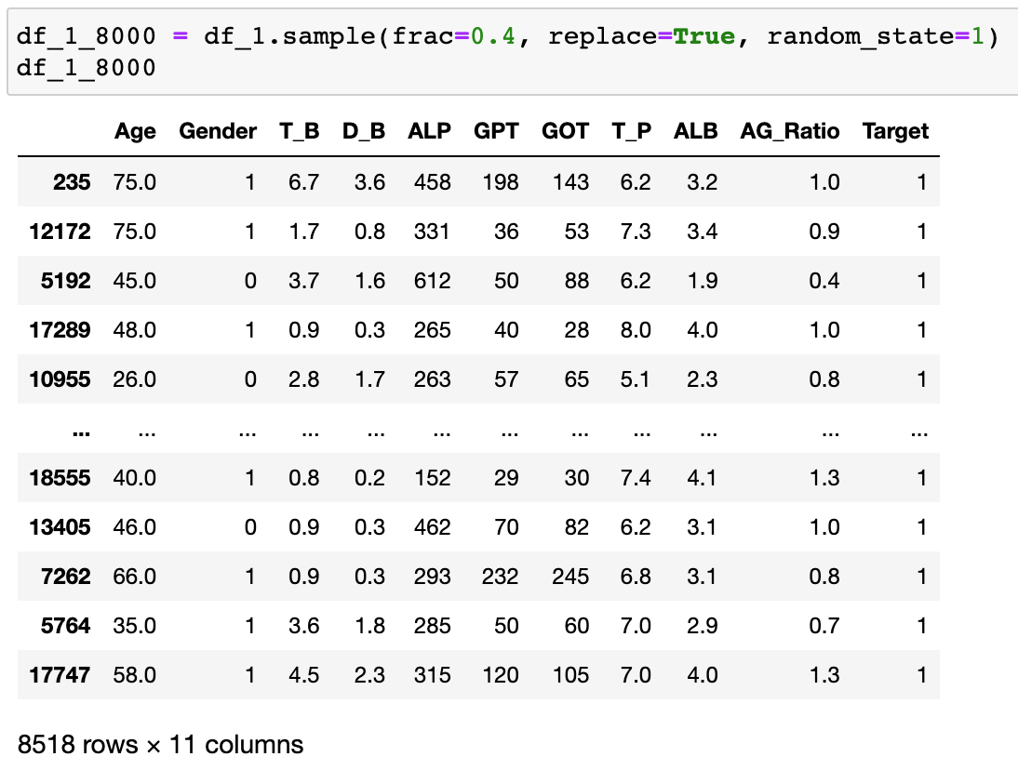
Data split and merge
Split my original data by Target (0 and 1) into two group
With liver disease group_1 (21,295 data point)
Sample function randomly extracts 40% of the data (8,518data points)
Without liver disease group_0 (8,494 data points)
Merge two group ( w/ and w/o liver disease) into one one dataset
17,012 data points and 11 features
Notes:
First, I split my original data into two group by Target (0 and 1)
Second, In the data with liver disease,
I use pandas sample function to randomly extract 40% of the data.
About 8000 data points are extracted.
Then, I merge data with and without liver disease two group into one new dataset.

Slide 10
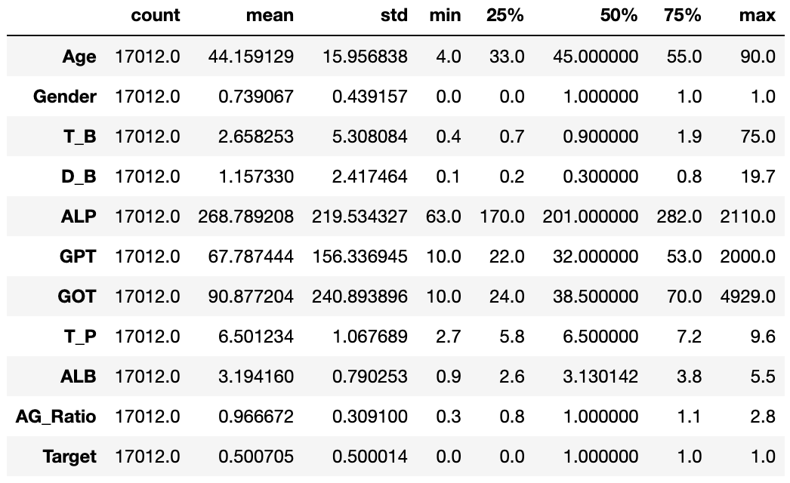
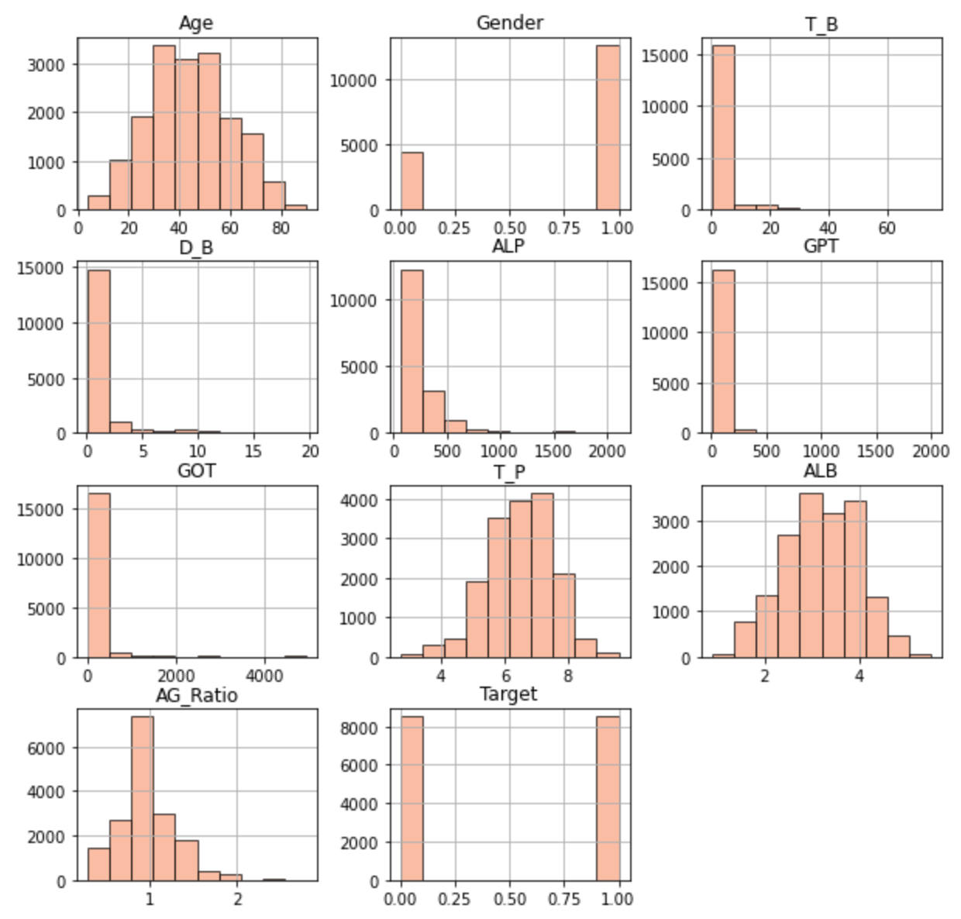
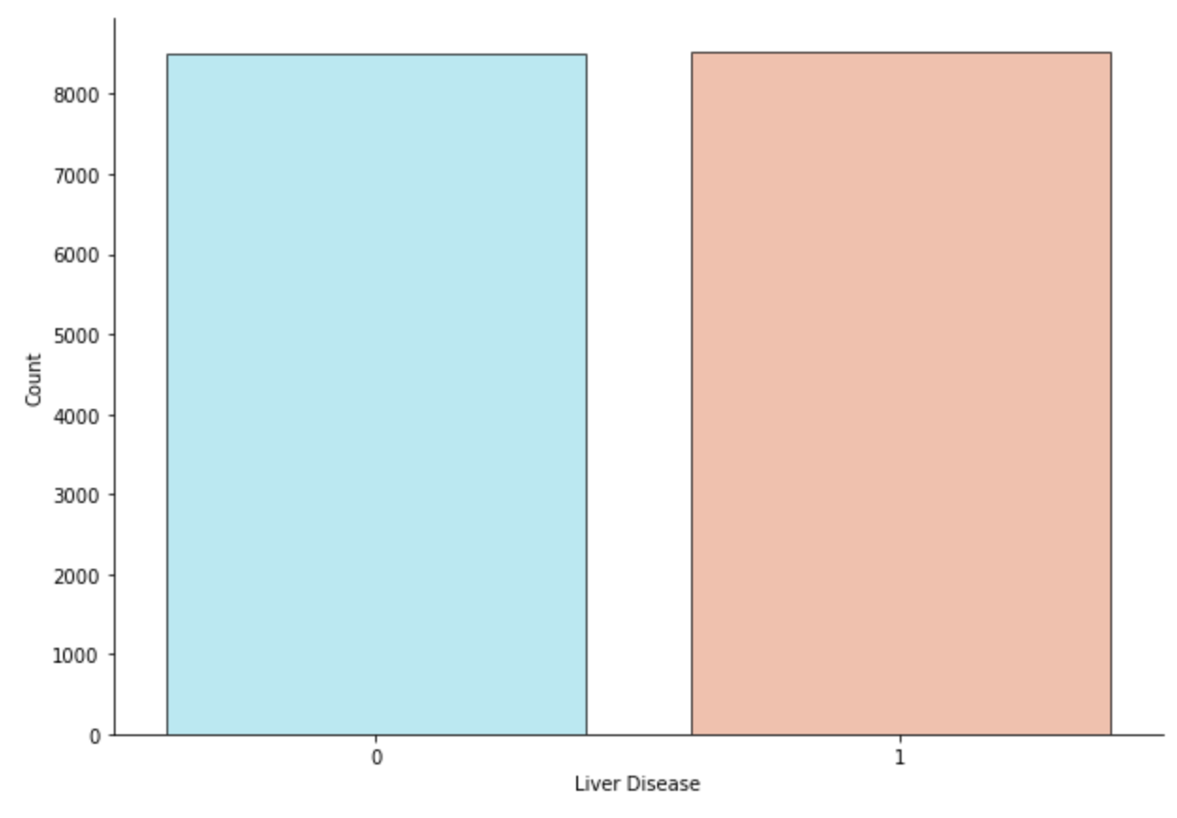
Balanced dataset
8,494 data points without liver disease
8,518 data points with liver disease
LD
No_LD
Notes:
After reorganizing them, I visualize my data to see if there are any changes.
From the bar plot, It looks like a much more balance dataset.
And I recheck their distributions which look similar to the former ones.
There are about 8,000 data points within each group now.

Slide 11
Are there any correlations between features?
Notes:
Next thing I want to check correlations between features before I analyze my data.
Maybe there are some redundant features that I would like to remove or essential features that I want to keep.
And, In the end, improve the performance of my models.

Slide 12
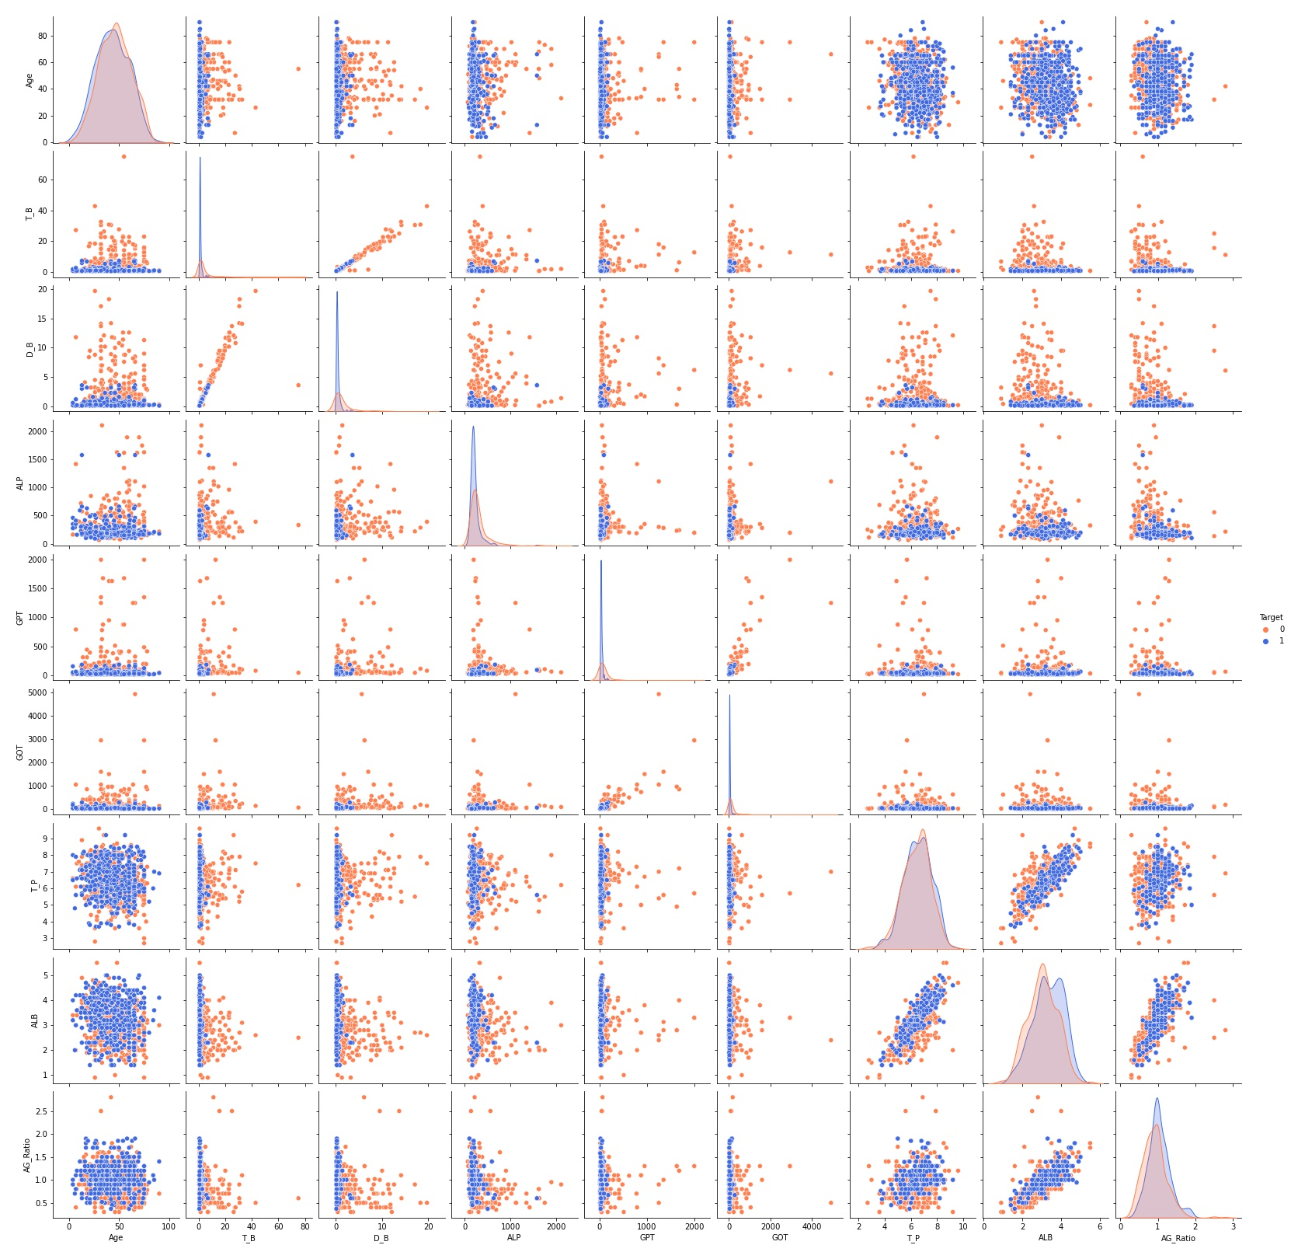
Correlations
Linear patterns between T_B and D_B
T_B
D_B
No_LD
LD
T_B
D_B
Notes:
First I am going to take a look at the pairplot.
A pairplot allows us to see both distribution of single variables and relationships between two variables.
Orange dots represent samples with no liver disease and blue dots represent samples with liver
From the pair plot, I can see the linear patterns between T_B and D_B.
And it suggest a presence of strong correlation between these two features.
Therefore I only have to pick one of the them when I go into further analysis.

Slide 13
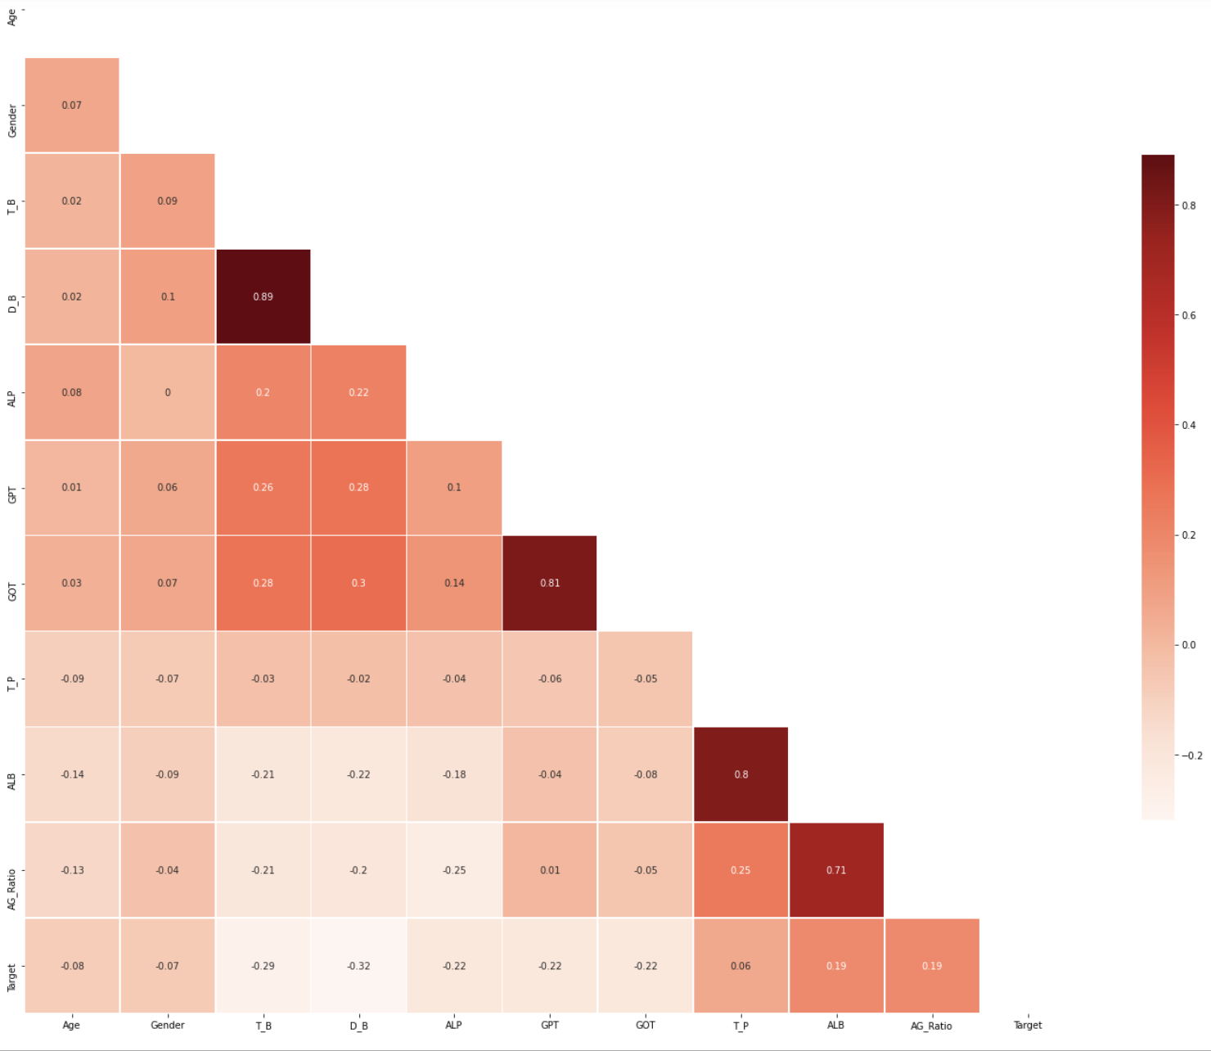
Correlations
Remove three features: Total bilirubin (T_B), GPT, and ALB.
T_B
D_B
GPT
GOT
T_P
ALB
ALB
AG_Ratio
Notes:
In this heatmap, a greater correlation shows a darker color and a higher score.
There are four areas in blue squares show strong correlations.
The feature of T_B and D_B, GPT and GOT, T_P and ALB, the last one is ALB and AG_Ratio.
In the end, I'm going to remove three features: T_B, GPT, and ALB.

Slide 14
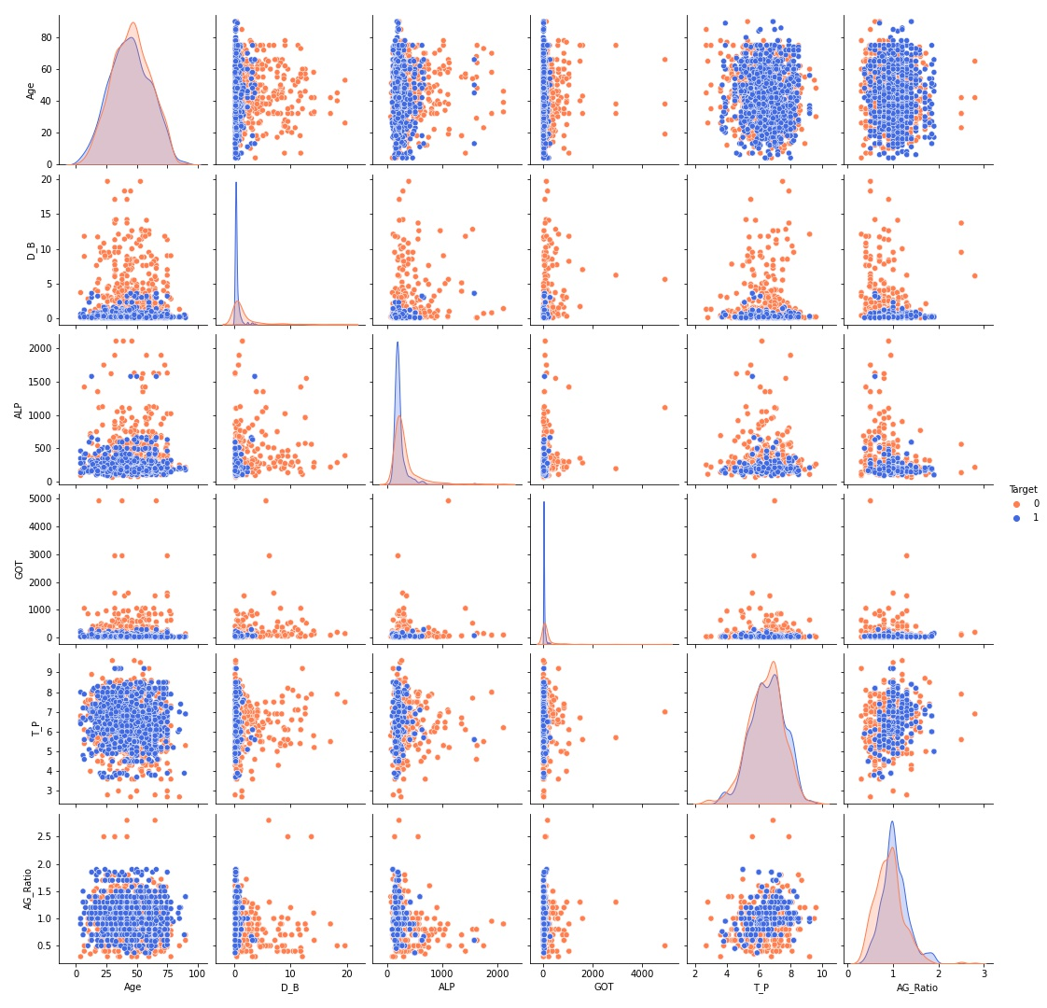
After Dropping unnecessary features
No_LD
LD
Notes:
After dropping these unnecessary features, there are less obvious linear patterns in the pairplot.

Slide 15
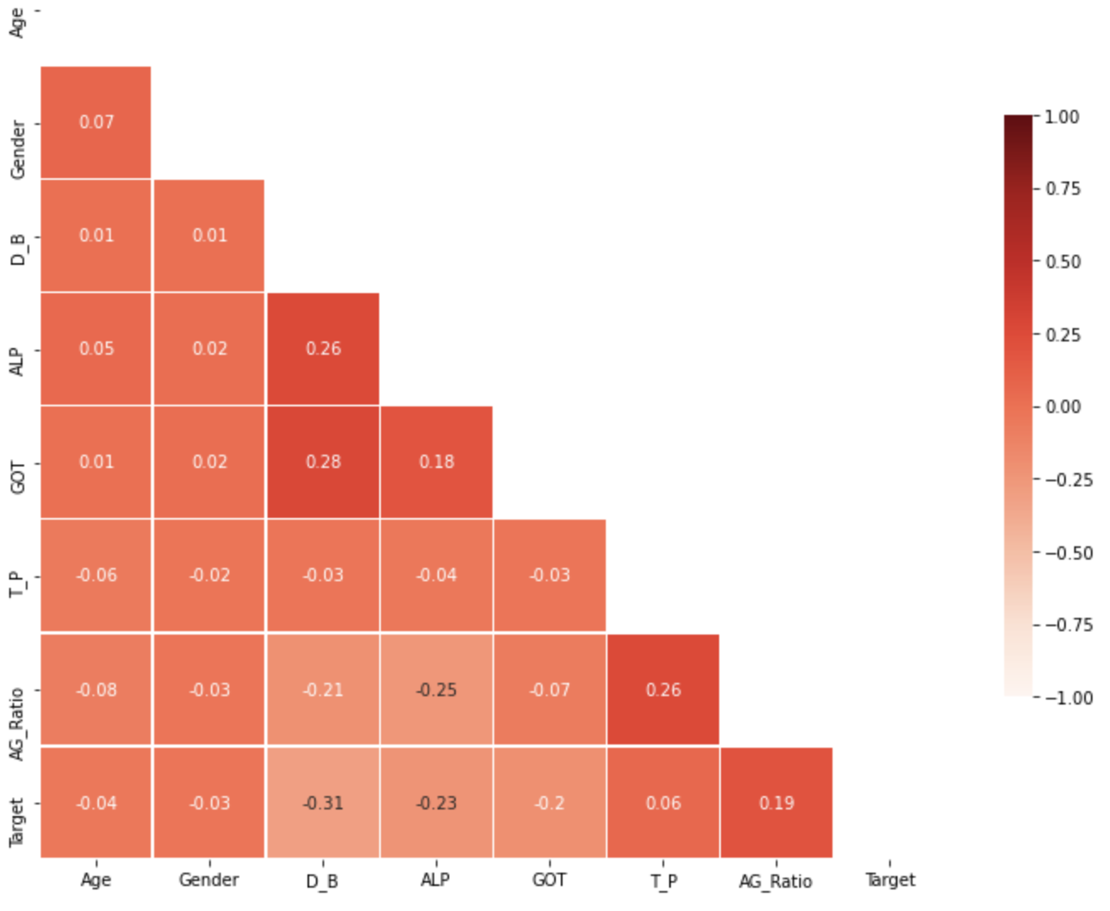
After Dropping unnecessary features
Remain features: Age, Gender, D_B, ALP, GOT, T_P, and AG_Ratio
Notes:
And the heatmap shows no strong correlation between each feature.
Which is a good sign.
Initially, I have 10 features.
After checking their correlations, I decide to move on with these 7 features which are Age, Gender, D_B, ALP, GOT, T_P, and AG_Ratio.
So, I’m going to build my model.

Slide 16
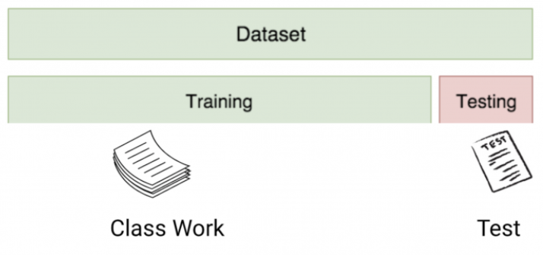
Training and test dataset
Training dataset:
The initial data used to train machine learning models
Test dataset
A secondary dataset that is used to test machine learning models after it has been trained on an initial training dataset
Training and test datasets must not have any overlap
https://cynthiachuang.github.io/What-is-the-Difference-between-Training-Validation-and-Test-Dataset/#:~:text=%E9%A9%97%E8%AD%89%E9%9B%86%EF%BC%88Validation%20Set%EF%BC%89%E6%98%AF,%E5%8F%AF%E4%BB%A5%E4%B8%8D%E4%BD%BF%E7%94%A8%E9%A9%97%E8%AD%89%E9%9B%86%E3%80%82
Notes:
Before building a model, I am going to talk about different datasets in machine learning.
The training dataset is a initial data used to train machine learning models.
So, they’re fed to machine learning algorithms to teach them how to make predictions.
The test dataset is a secondary dataset which is used to test machine learning models after is has been trained on a training dataset.
Generally, test dataset is used to test your model to see if it is working properly or not.
Training and test datasets must not have any overlap, so that test datasets can really measure the capabilities of your models.
Normally, people suggest that 70% of the available data is allocated for training set and 30% is allocated for test set.
The way I would like to think about the training and test dataset is that
Training dataset just like studying in class.
And test dataset just like the final exam, it is used to assess your final learning results.

Slide 17
Logistic Regression
Splitting data into training and test sets
Training size : 11,908 (70%)
Test size : 5,104 (30%)
Try single feature
D_B ( -0.31)
https://www.researchgate.net/post/Is-there-an-ideal-ratio-between-a-training-set-and-validation-set-Which-trade-off-would-you-suggest#:~:text=Normally%2070%25%20of%20the%20available,validation%20and%20test%20data%20sets.
https://www.sciencedirect.com/topics/computer-science/logistic-regression#:~:text=Logistic%20regression%20is%20a%20process,%2Fno%2C%20and%20so%20on.
Notes:
So, it’s time to apply my first model
The first model I used is Logistic Regression model.
Logistic regression is a process of modeling the probability
The most common logistic regression model is based on binary outputs
For example, like true/false, yes/no, and so on.
And it is a useful analysis method for the classification problem which is what I have.
First, I split my dataset into training and test datasets with training size 70% and test size 30%
Then, first I try a single feature by picking a variable (D_B) based on the heatmap score just to get started

Slide 18
Standardize the Data
fit()
Training dataset only.
Find the mean, variance, maximum and minimum values of the training dataset
transform()
Both the training set and the test dataset.
Normalization and standardization
Notes:
Next, I have to standardize my dataset.
Fit is the function used on the training dataset only
In order to find the mean, variance, maximum and minimum values of the training dataset,
the inherent properties of the training dataset.
Transform is the function used on both the training and test dataset
The reason why we use transform function is to scale the data
normalize and standardize them.

Slide 19
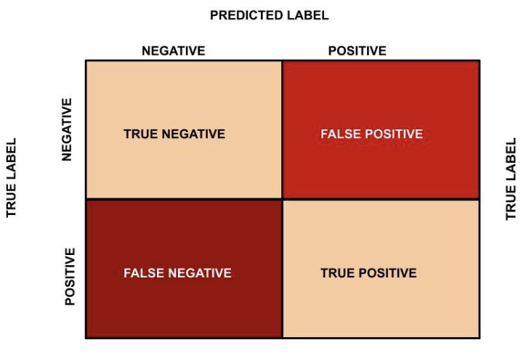
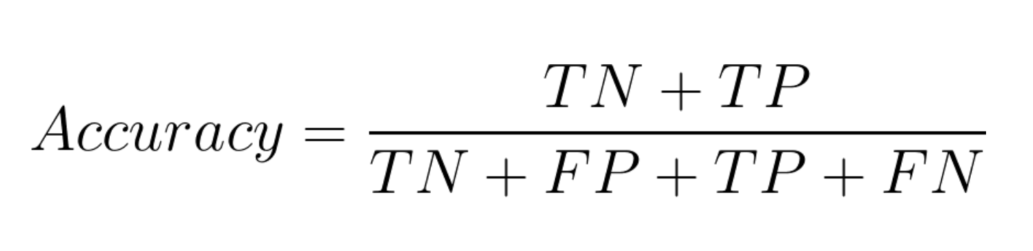
Confusion matrix
https://medium.com/analytics-vidhya/confusion-matrix-accuracy-precision-recall-f1-score-ade299cf63cd
Notes:
Before I discuss the result with you, I’m going to talk about the confusion matrix
The x-axis shows a predicted label and the y-axis shows a true label
And we have positive and negative under our labels.
The upper left corner presents the true negative value. Just like people with no liver diseases and were predicted negative.
The lower right corner presents the true positive value. Like people with liver diseases and were predicted positive.
The upper right corner presents the false positive value. Like people with no liver diseases and were incorrectly predicted positive
The lower left corner presents the false negative value. Like people with liver diseases and were incorrectly predicted negative
To calculate the accuracy of the confusion matrix, there is a equation right here.
So first added up TN and TP ,and then divided them by all four parts will get the accuracy score

Slide 20
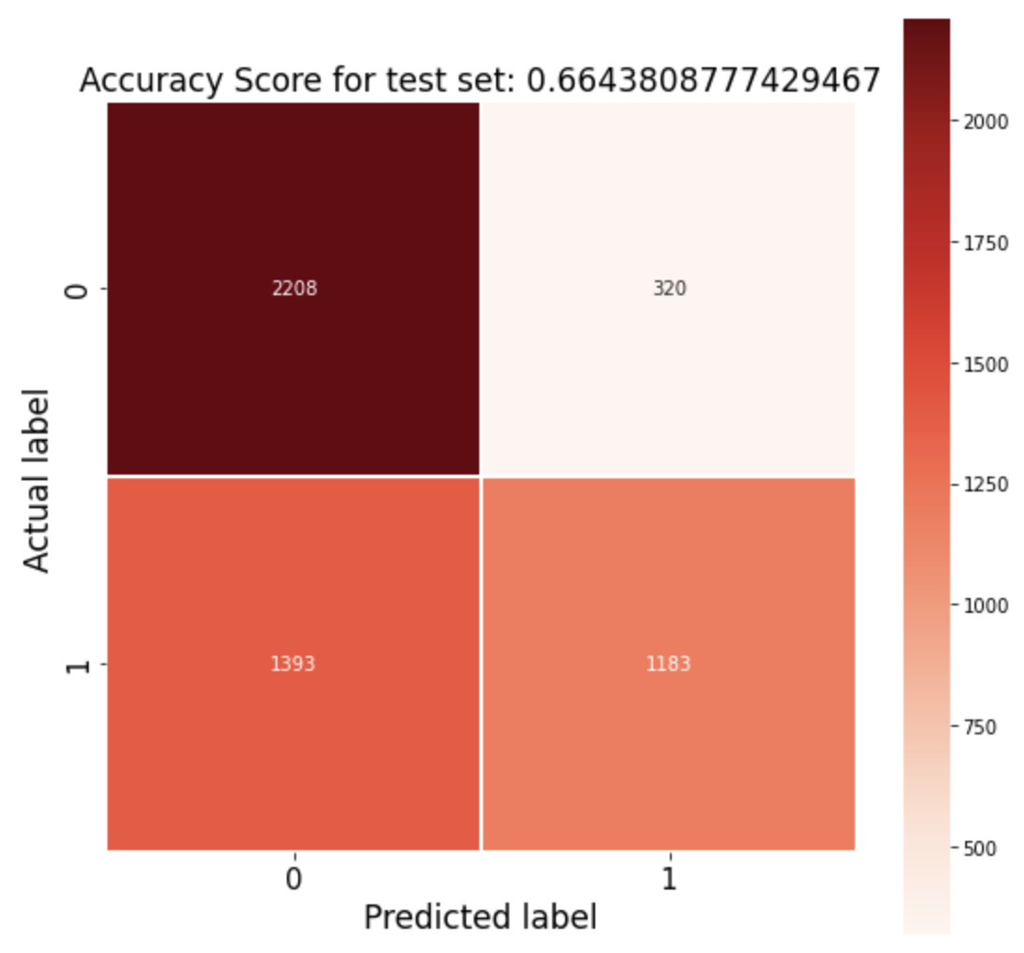
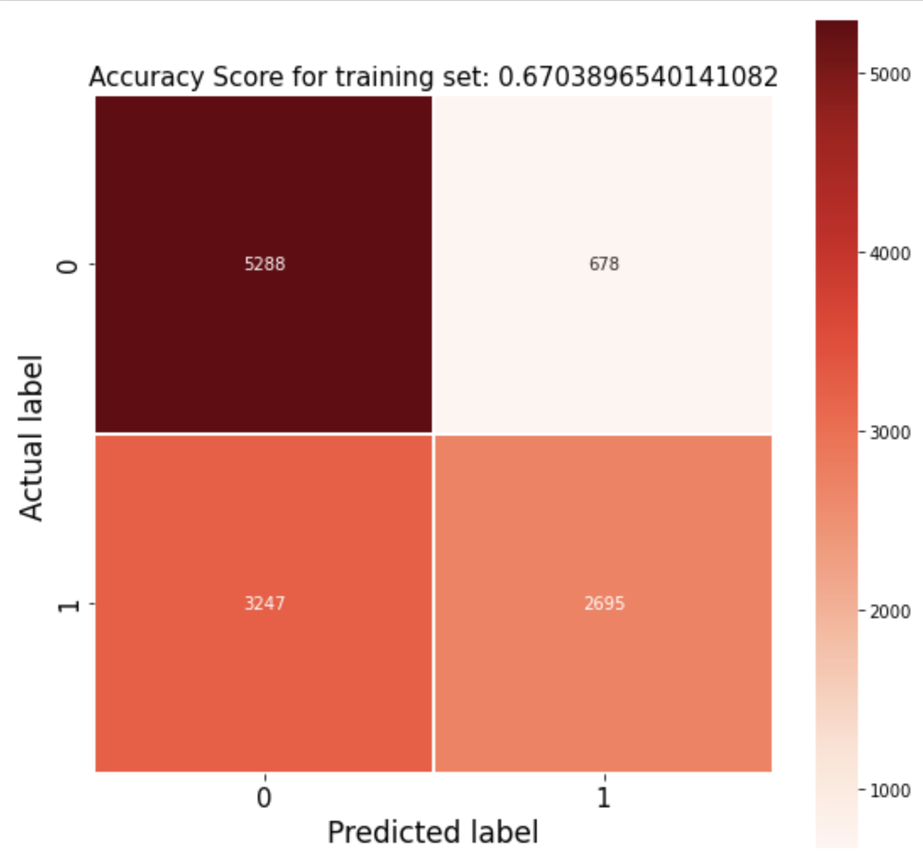
Logistic Regression with one feature
test dataset accuracy: 66%
training dataset accuracy: 67%
https://medium.com/analytics-vidhya/confusion-matrix-accuracy-precision-recall-f1-score-ade299cf63cd
Notes:
This is the result I got from my logistic regression with only one feature of D_B
The accuracy of test dataset is 66% and the training dataset accuracy is 67%
It is not the ideal score that I want because I only use one feature.
So, now I’m going to use logistic regression with all feature in my dataset and build a more complicate model.

Slide 21
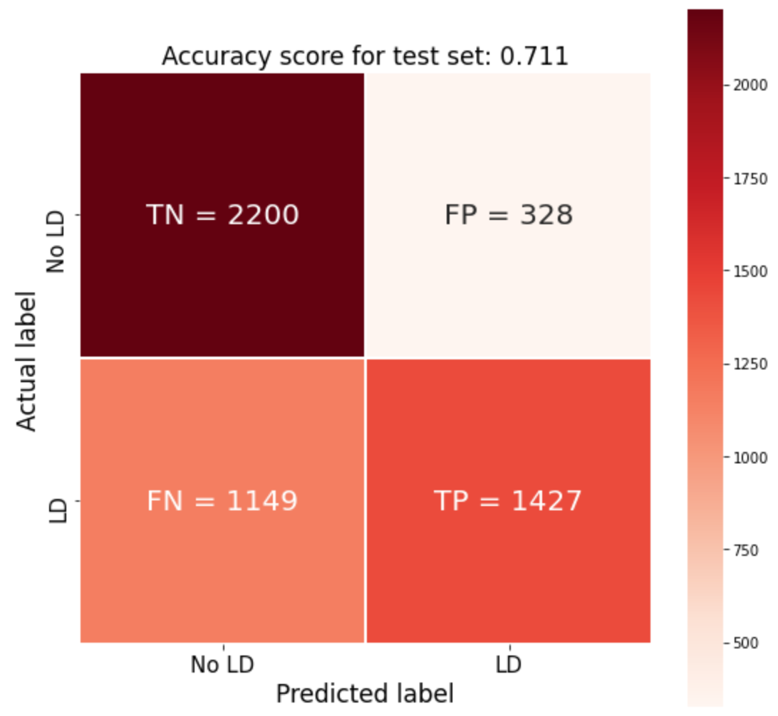
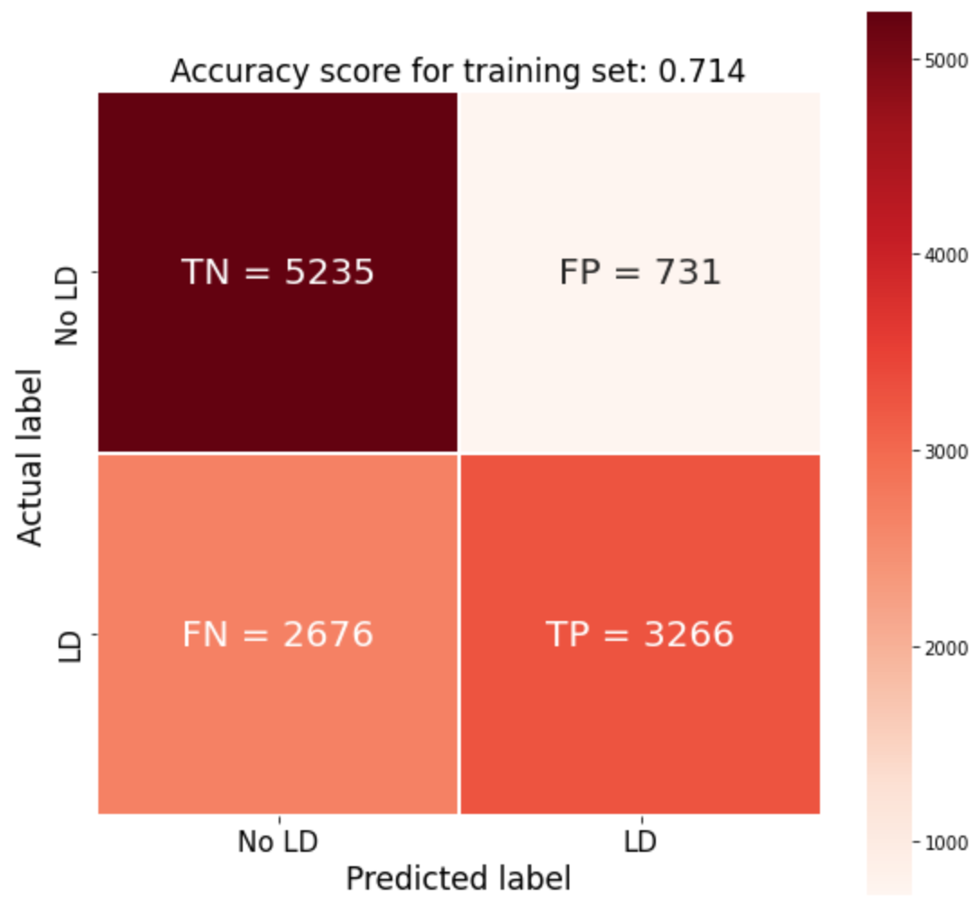
Logistic Regression with all features
test dataset accuracy: 71%
training dataset accuracy: 71%
https://medium.com/analytics-vidhya/confusion-matrix-accuracy-precision-recall-f1-score-ade299cf63cd
Notes:
When I use logistic regression with all features,
The accuracy of test dataset increases from 66% to 71% and the training dataset accuracy also increases from 67% to 71%
However, it is still not the best score.
Therefore, I’m going to find out the best model by comparing different models all together.

Slide 22
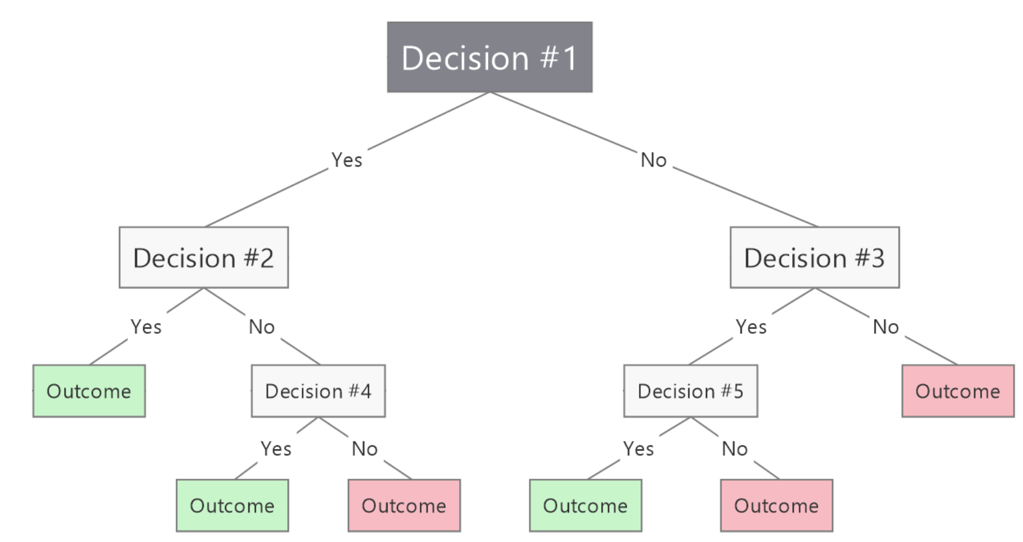
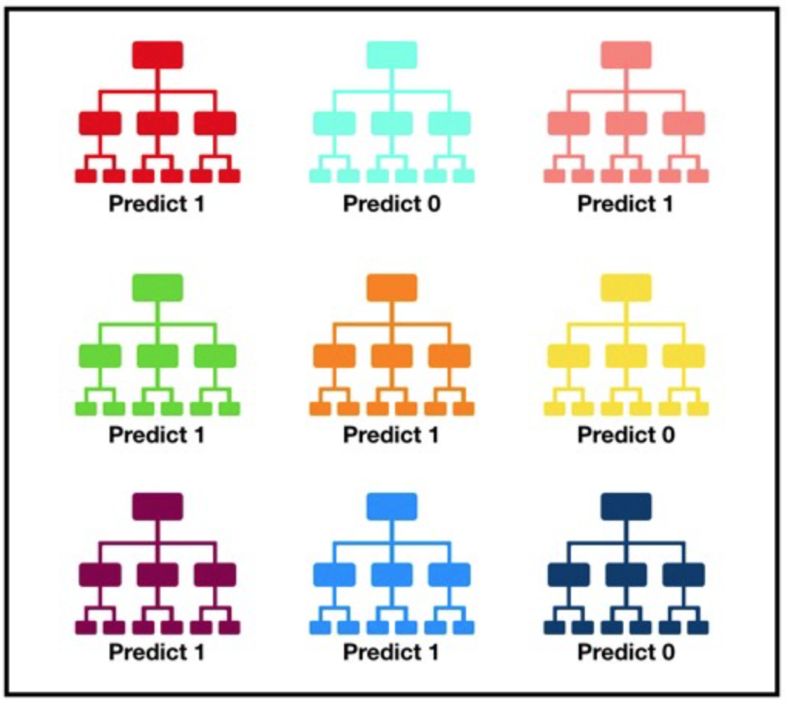
Find best model
root
Logistic regression
Decision tree
Random forest
branch
leaf
https://blog.mindmanager.com/blog/2021/05/11/decision-tree-diagrams/
https://pyecontech.com/2019/07/15/decision_tree/
Notes:
This time, I’ll compare logistic regression, decision tree, and Random forest.
I’ve talked about the logistic regression model,
so now I’m going to talk about decision tree.
The decision tree is a Supervised Machine Learning model.
It is like a tree, branching from the root to the trunk to the leaves.
The part of each node is a feature.
A step-by-step breakdown of features will yield outputs on whether patients have liver disease or not.
Random forest is a Supervised Machine Learning Algorithm that is used widely in Classification and Regression problems.
It builds decision trees on different samples and takes their majority vote for classification and average in case of regression.
For example, in this figure, there are total 9 decision trees, 6 of them predict 1 and 3 of them predict 0. So, the most votes 1 becomes the model’s prediction.

Slide 23
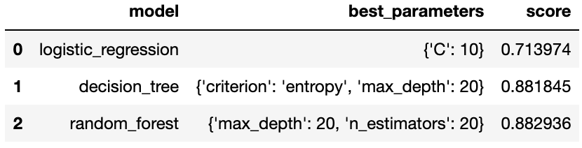
Find best model
Logistic regression
Decision tree
Random forest
the highest accuracy!
The average random forest model accuracy : 88%
Notes:
After checking with these three models,
I found that the random forest model has the highest accuracy
Its accuracy is 88% which is higher than logistic regression and decision tree.
I can also see that decision tree and random forest have a much higher score than the logistic regression
But it’s known that with tree-based models, the score I get may be due to a so-called overfitting problem
So, I have to double check whether the relatively high score is due to the overfitting issue.

Slide 24
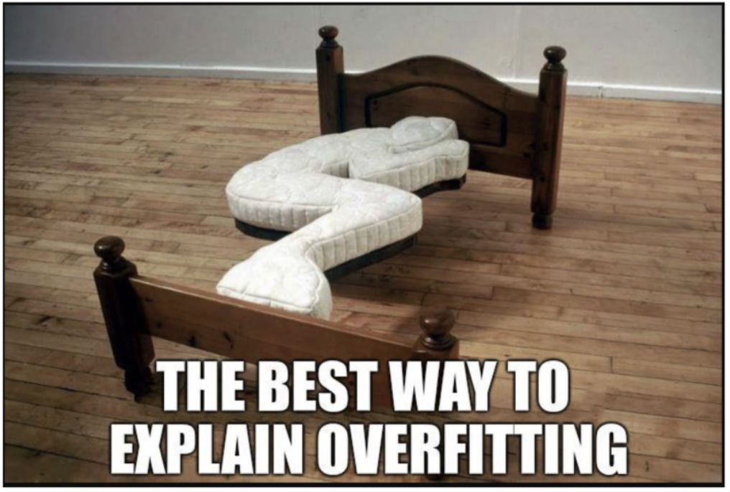
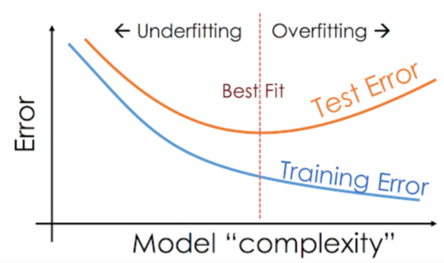
Overfitting
Overfitting problem
The model performs too well on the training dataset but the performance drops significantly over the test
https://www.analyticsvidhya.com/blog/2020/02/underfitting-overfitting-best-fitting-machine-learning/
Notes:
Overfitting is , as the name implies, over-learning the training data, and it becomes hard to predict other data that is not in the training dataset
Any model perform too well on the training dataset but the performance drops significantly over the test dataset.
Let see the figure below,
As the model complexity increases, we can reduce the training error but simultaneously increases the test error.

Slide 25
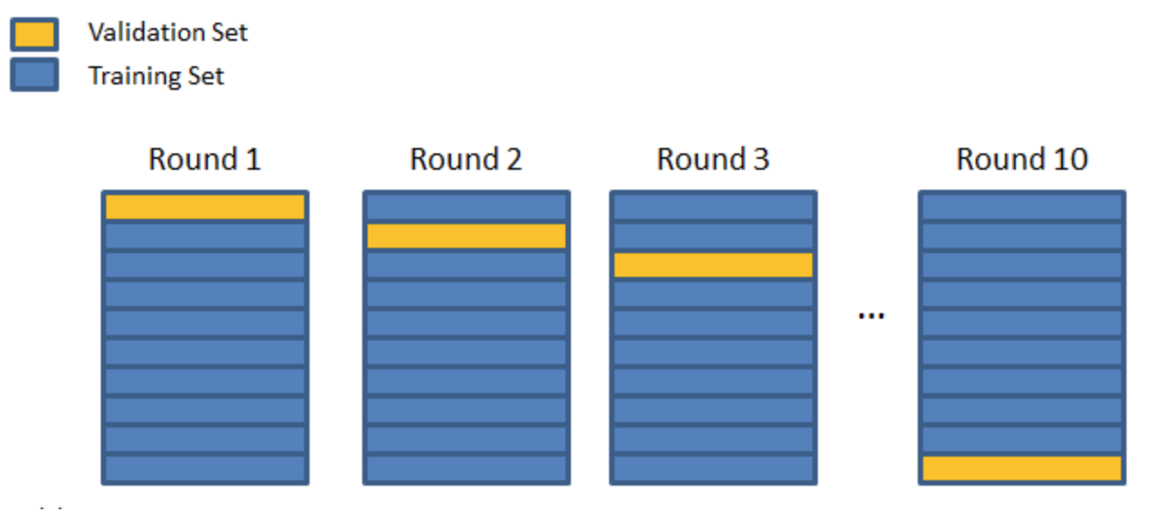
Cross validation
Average Accuracy is 88%
https://towardsdatascience.com/cross-validation-explained-evaluating-estimator-performance-e51e5430ff85
Notes:
So, by using cross validation, we can detect overfitting problem.
Cross validation is a technique for evaluating machine learning models by training several models on subsets of the available input data and evaluating them on the complementary subset of the data.
There are different types of Cross Validation Techniques, but the overall concept remains the same,
So, the first step is to partition the data into a number of subsets, in this case, there are 9 subsets.
Second, Hold out a set at a time and train the model on remaining set, the set in yellow is the hold-out set.
Third, test the model on hold-out set
The last step is to repeat the process for each subset of the dataset
In the end, my average of Accuracy is 88%

Slide 26
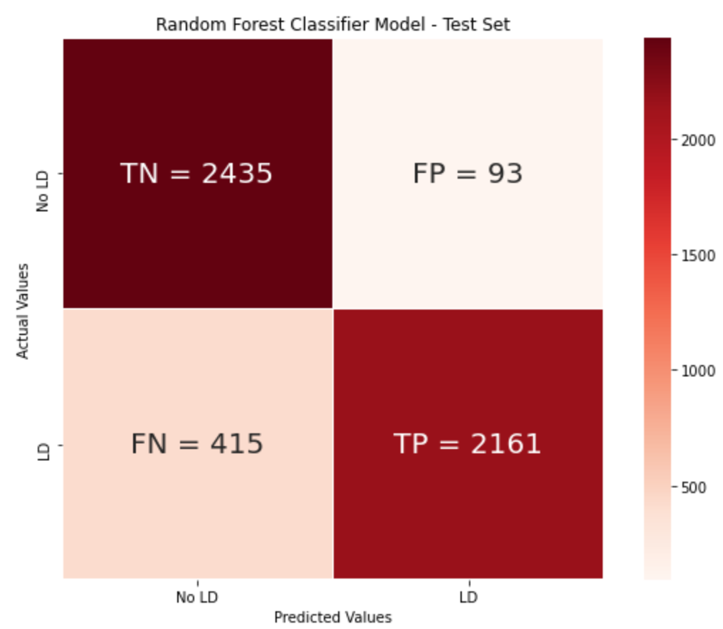
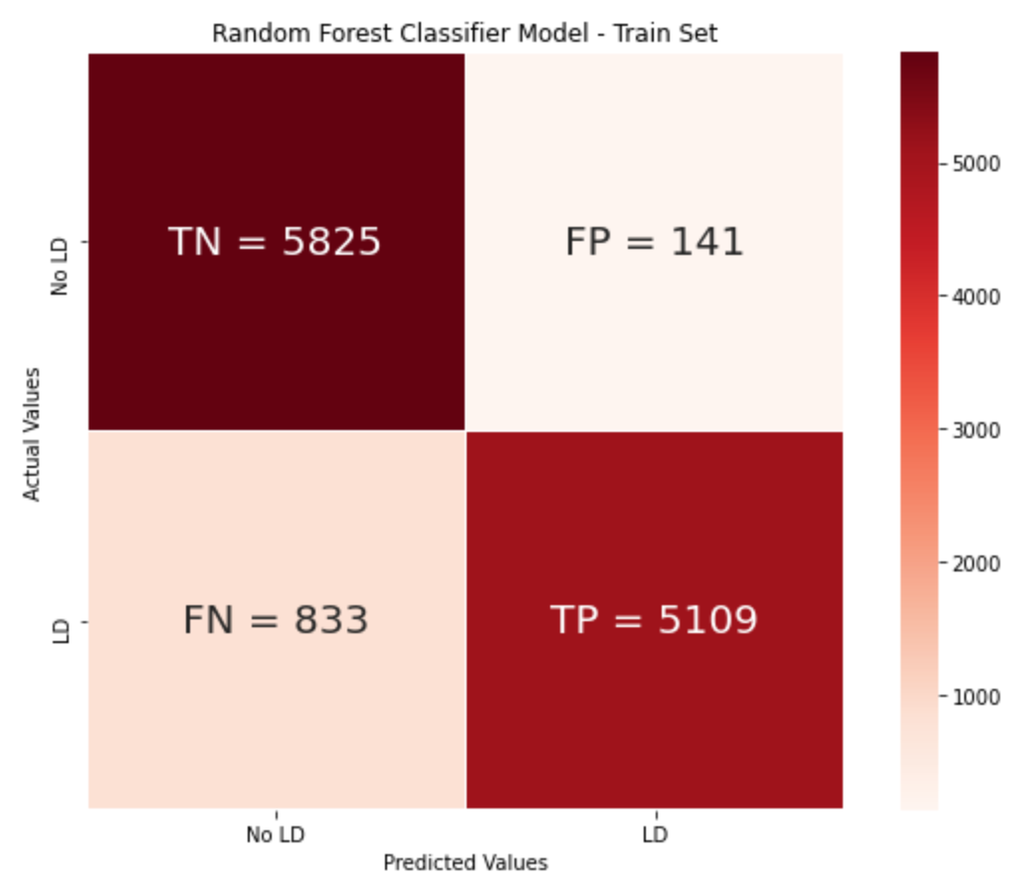
Model Evaluation
Test dataset accuracy: 90%
Training dataset accuracy: 91.8%
Notes:
So, after using cross validation, I evaluate the performance of my model.
the accuracy of test dataset is 90%
And the accuracy of training dataset is 91.8%, almost 92%
The higher score that I got from the training dataset is almost 4% higher than the Average Accuracy of cross validation

Slide 27
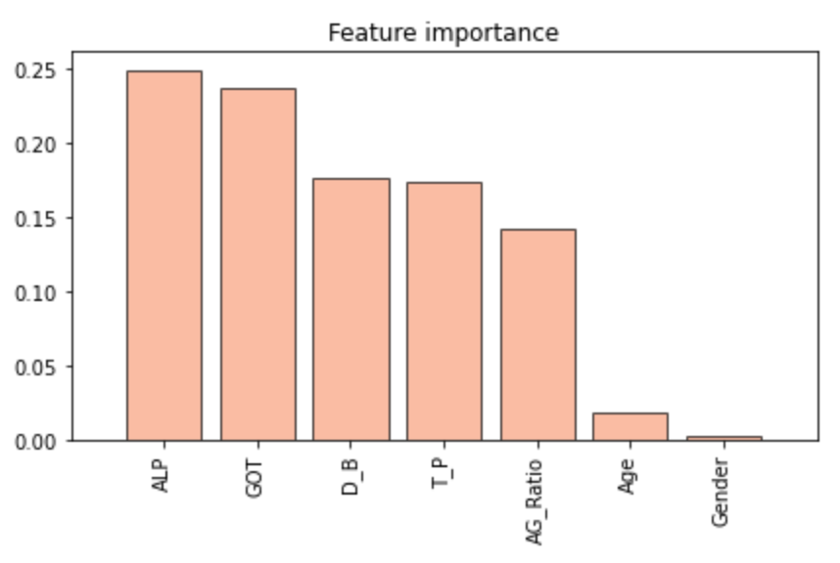
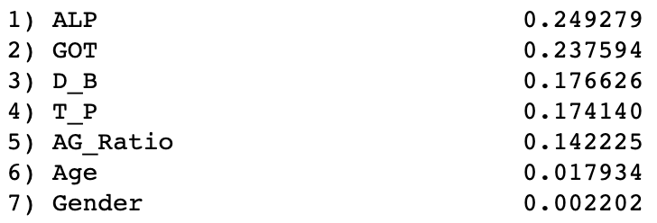
Feature importance
ALP, GOT, D_B, T_P, and AG_Ratio are the top five important features in my dataset
Notes:
The next thing I would like to do is to rank my features and see which one is more important
So I use random forest to rank my features.
The reason why I want to do that is to see if some features are not that important, then I can remove them
And improve my accuracy.
In this slide, we can see that ALP, GOT, D_B, T_P, and AG_Ratio are the top five important features in my dataset
On the other hand, Age and Gender are not that essential
Thus, I decide to remove these two features.

Slide 28
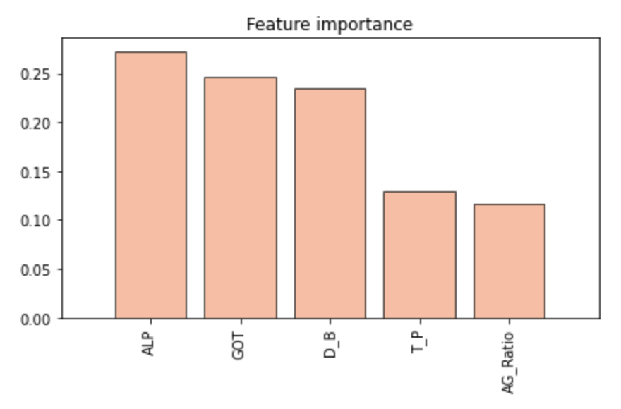
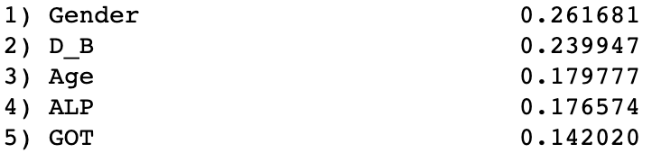


After removing age and gender
Average Accuracy: 91%
Test dataset accuracy: 90%
Training dataset accuracy: 94%
Notes:
After removing the feature age and gender
The cross validation average Accuracy slightly increases to 91%
the accuracy of test dataset is still around 90%
And the accuracy of training dataset slightly increases to 94%
So, by removing age and gender, my training dataset accuracy is improved.
Then, I’m going to use this model to predict new data which is obtain from my former co-work in the hospital.

Slide 29
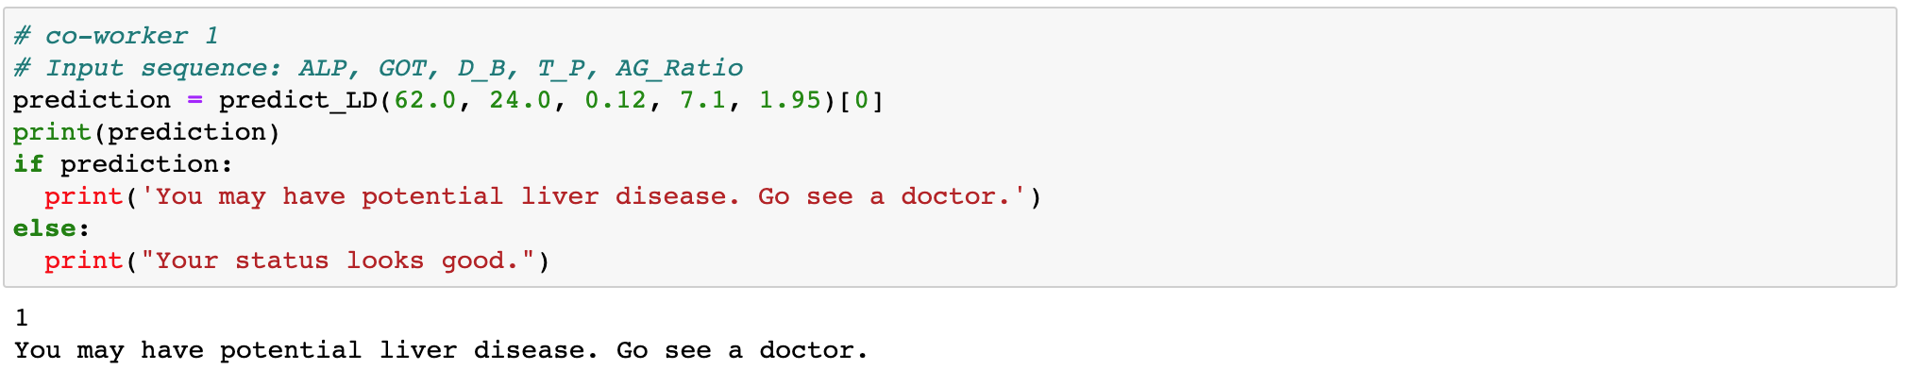
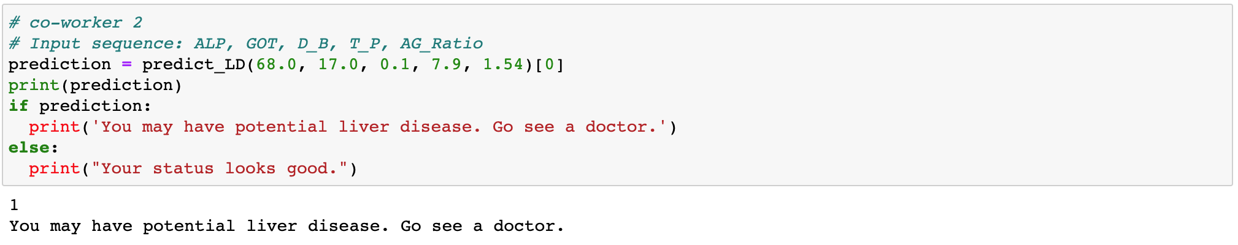
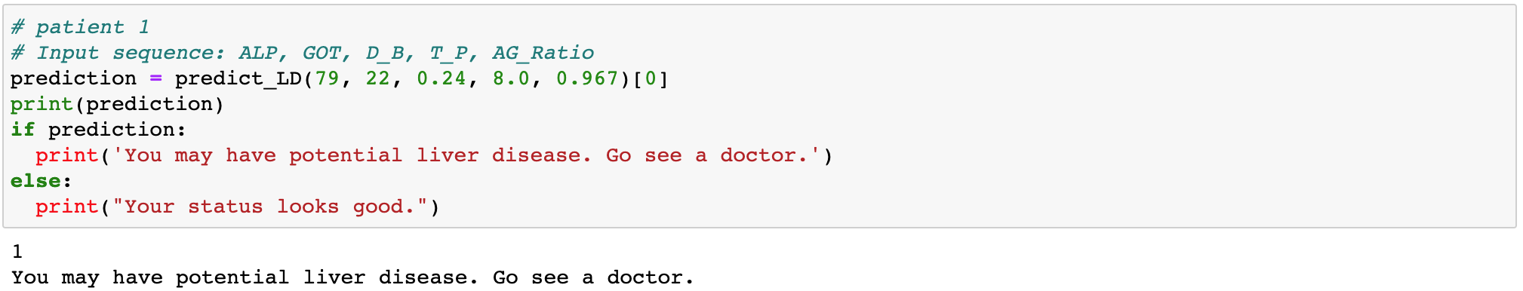
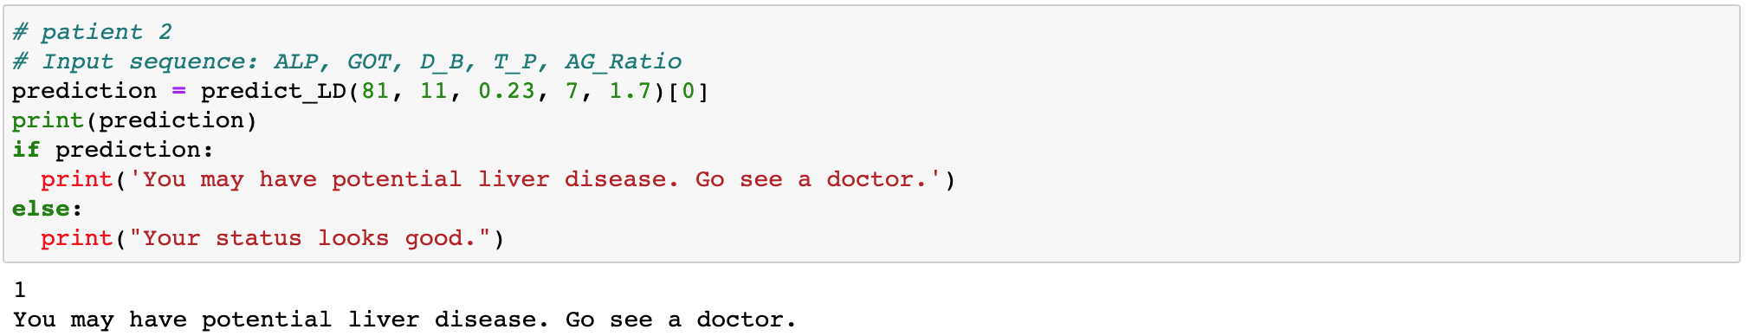
Make Predictions
Notes:
The first two samples’ blood tests are obtained from my co-workers themselves who are both healthy
And the last two samples’ blood tests are gained from people with slightly abnormal liver function, but they still consider healthy
However, all results show that they might have liver disease.

Slide 30
Possible reasons
Imbalance dataset
8,494 data points without liver disease
8,518 data points with liver disease
Overfitting problem
Test dataset accuracy: 90.05%
Training dataset accuracy: 94.59%
Dataset with duplicates
Duplicates in the training data
Duplicates in the test data
https://stats.stackexchange.com/questions/392216/removing-duplicates-before-train-test-split
https://datascience.stackexchange.com/questions/35713/i-got-100-accuracy-on-my-test-set-is-there-something-wrong
https://stats.stackexchange.com/questions/392216/removing-duplicates-before-train-test-split
Notes:
I have listed three common possible reasons for incorrect predictions.
First, the most common reason for incorrect prediction is the imbalanced dataset.
To be more specific, if one group is 100 fold greater than the other group,
it could be possible that my model only select one certain group to go through the train and test process.
So, the training and test scores are always high but didn’t work well with data from other dataset.
However, I have modified my dataset with the same amount of data points in two groups.
Therefore, it is not likely to be the reason.
Second, it could be the overfitting problem.
I found that some people discuss in stack over flow mention that
the best models have high accuracy on training data and equally high accuracy on test data
Plus, both accuracy metrics are not more than 5~10% of each other, which shows model stability.
The lower difference the better.
So I quickly review my test and training accuracy score:
The test dataset accuracy is 90%
The training dataset accuracy is 94%
Although the accuracy of my model looks like it fit the definition of a good model,
a simple definition of overfitting is “when a model is no longer as accurate as we want it to be on data we care about.”
So, here comes the last possible reason.
If you have duplicates in your training and test datasets, it’s expected to have high accuracies
When you have duplicates in the training dataset, it is effectively the same as having its 'weight' doubled.
That element becomes twice as important when the classifier is fitting your data,
and the classifier becomes biased towards correctly classifying that particular scenario over others.
When you have duplicates in the test dataset,
you'll get an inflated sense of how well the model performs overall,
because the rarer scenarios are less well represented, and the classifier's poor performance with them will contribute less to the overall test score.
So, let take a look at my dataset!

Slide 31
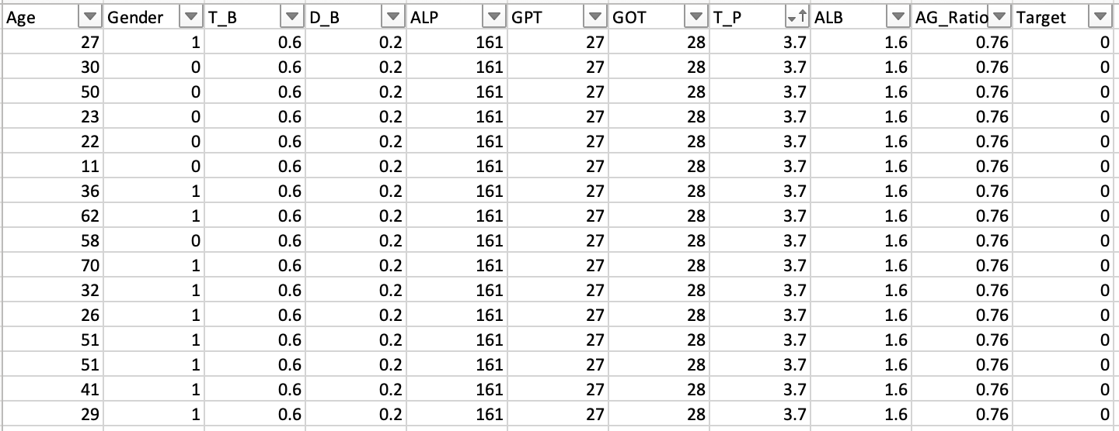
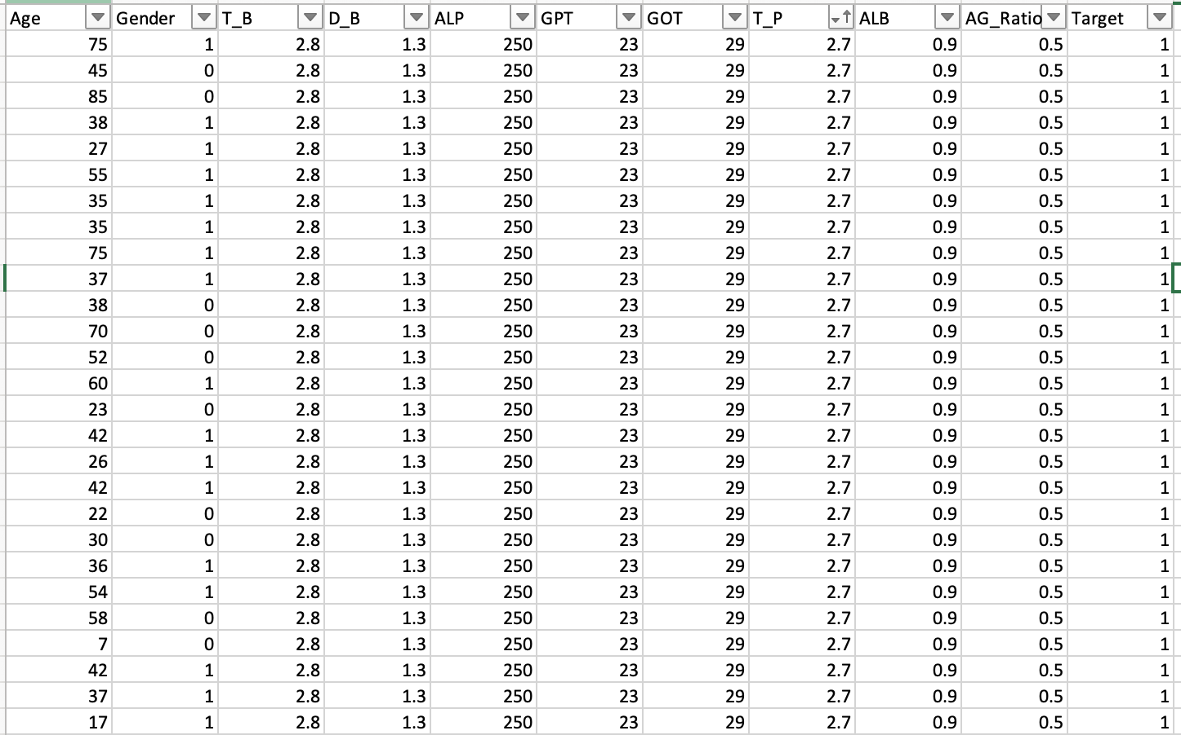
Duplicates
Notes:
The figure above is the dataset I screenshotted from the group without liver disease.
And the figure below is the dataset I screenshotted from the group with liver disease.
After I remove Age and Gender,
Within different groups, all features are showed exact the same.
So it might cause the model keep learning from the same training data and increasing the weight.
And it also inflated the score of test dataset accuracy due to these duplicates.
However, the model have not encountered any new data with different values.
In the end, it predict incorrectly.

Slide 32
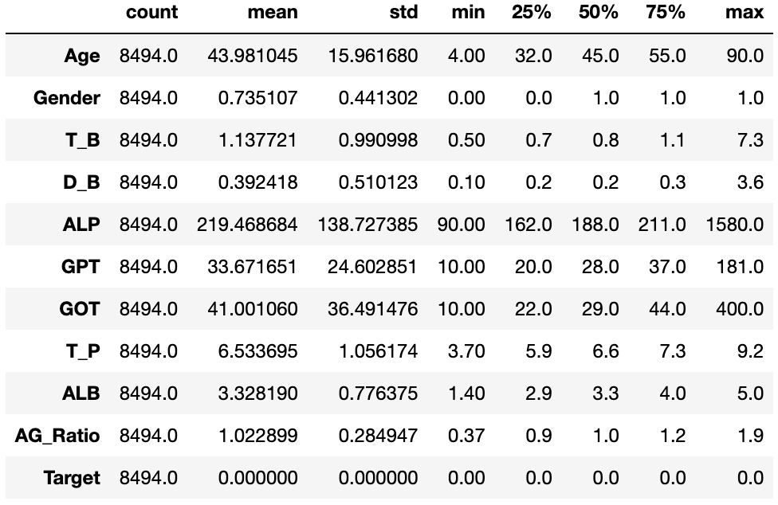
The last possible reason
Normal ranges
Alkphos Alkaline Phosphotase (ALP):
44-147 international units per liter
GOT: 8-45 international units per liter
Direct Bilirubin (D_B):
0.3 milligrams per deciliter (mg/dL)
T_P: 6-8.3 grams per deciliter (g/dL)
AG_Ratio: 1.1-2.5
https://www.portea.com/labs/diagnostic-tests/liver-function-144/
Notes:
From my personal point of view, There is another possible reason
which is the different normal range of each feature
For example, the figure below is the description of non-liver disease group
And the most important feature in my dataset is ALP
However, the mean of ALP is 219 and the median of ALP is 188 while the actual normal range in reality is 44-147
So as the third important feature D_B
its mean is 0.39 while the actual normal range in reality is below 0.3
So it may cause an issue when comparing with true normal range.

Slide 33
Future direction
Remove those duplicates
Obtain datasets from hospital
Search other features
Gamma-glutamyltransferase (GGT)
L-lactate dehydrogenase (LD)
Prothrombin time (PT)
5'-nucleotidase (5’-NT)
Try more models
https://www.analyticsvidhya.com/blog/2017/09/common-machine-learning-algorithms/
Notes:
So, for my future direction,
First thing I could do is to remove those duplicates in my dataset since it has already affected my prediction.
Or, I can try to obtain real dataset from my former co-workers if possible.
Then, I would like to include more features that is correlated with liver disease, such as Gamma-glutamyltransferase (GGT), L-lactate dehydrogenase (LD), Prothrombin time (PT), 5'-nucleotidase, etc.
Last but not least, I would like to try more models since I just used Logistic regression with single and multiple features, decision tree and random forest In this final project.
But there are still plenty of other machine learning methods that I can explore with.

Slide 34
Thank you.
Notes:
Ok, that’s all for my presentation.
I’d like to thank Dr. Baloglu help me finish this project and solve every problems that I have encountered
And Thank you for your listening.

